Slide 1

18 Monate Copilot
Daniel Hager,
Technical Specialist Microsoft
https://globalai.community/chapters/vienna
Notes:
https://globalai.community/chapters/vienna

Slide 2
How it Started

Slide 3
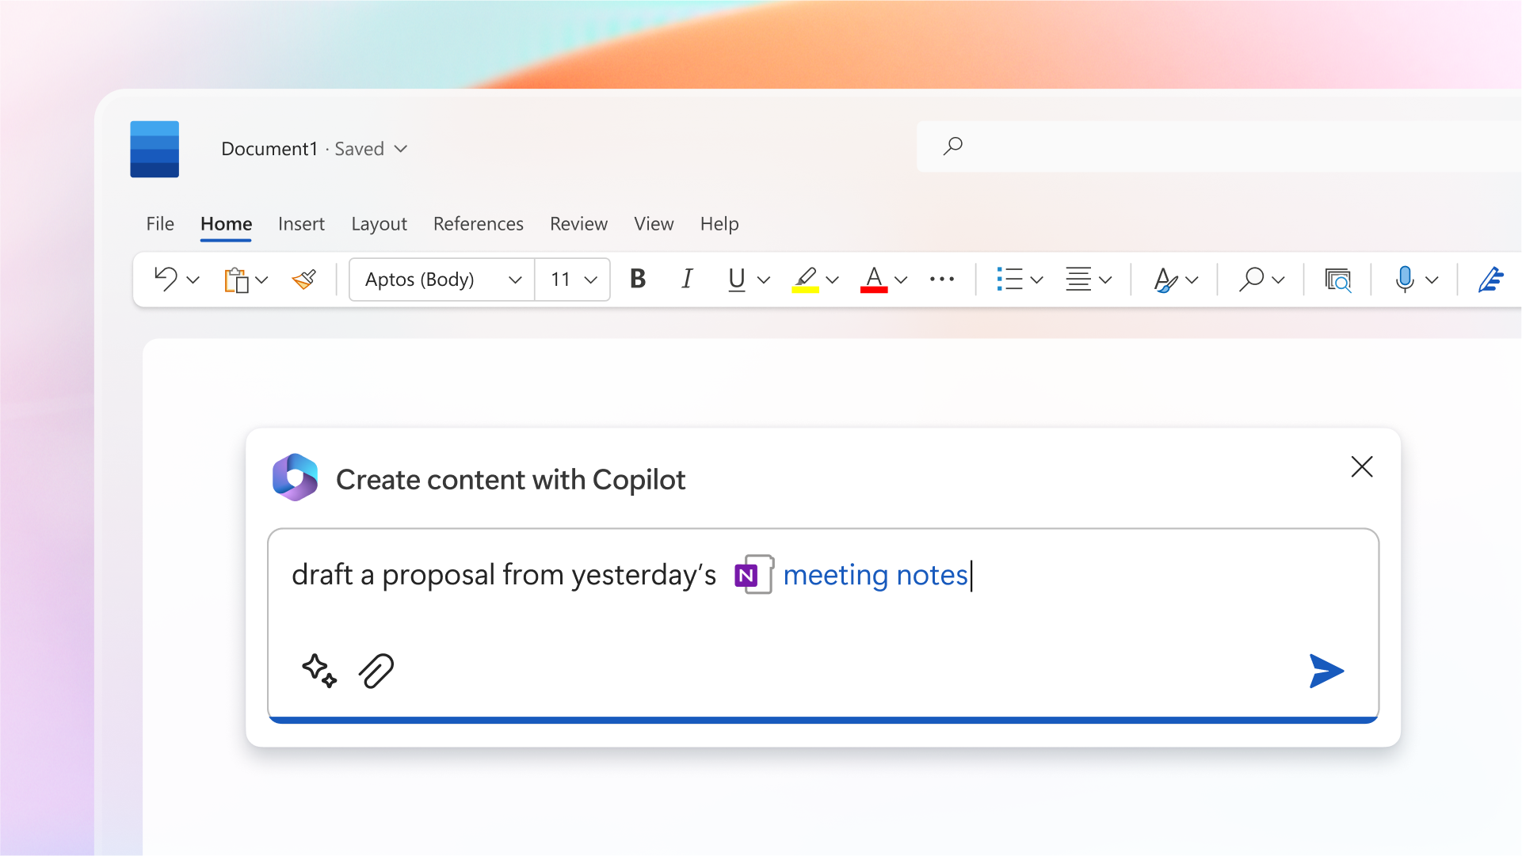
16.03.2023 - Introducing Microsoft 365 Copilot – your copilot for work

Slide 4
New Technologies

Slide 5
Why do customers need a Semantic Index ?
Semantic Indexes​
Understand a document’s meaning and context.​
More accurate at matching documents to the user’s intent
Query: “Coffee”​
Document 1: “coffee”​
Document 2: “coffee”​
Document 3: “tea”​
Document 4: “hot beverage”

Slide 6
Challenges with new Technologies

Slide 7
Please Wait to be Seated
EAP: The Semantic Index will need 14 to 21 Days to work
Now: When Microsoft Graph data is indexed for a customer for the first time, documents created by users are indexed in near real-time in the user's mailbox. New documents that are added to SharePoint Online sites that are accessible, via site inheritance, by two or more users are indexed daily. When an indexed user and tenant level document is updated, the changes are immediately indexed.

Slide 8
Oversharing
My customer is concerned about oversharing through links. When I create a link for Everyone does that mean the file will show up in search results or Microsoft 365 Copilot responses for everyone?

Slide 9
Oversharing
When you create a file sharing link for everyone it does NOT mean that the file will show up in everyone’s search results or Microsoft 365 Copilot responses. A user must click a link to indicate access to the file, and only after that does it become part of their Graph and Semantic Index. If a link is revoked or the file is deleted, the user no longer has access to the file, and it no longer appears in their search results or Copilot responses.

Slide 10
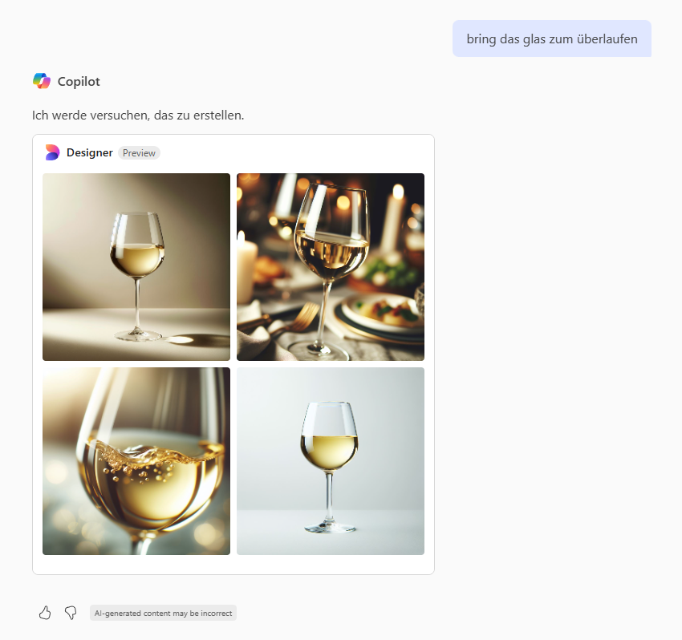

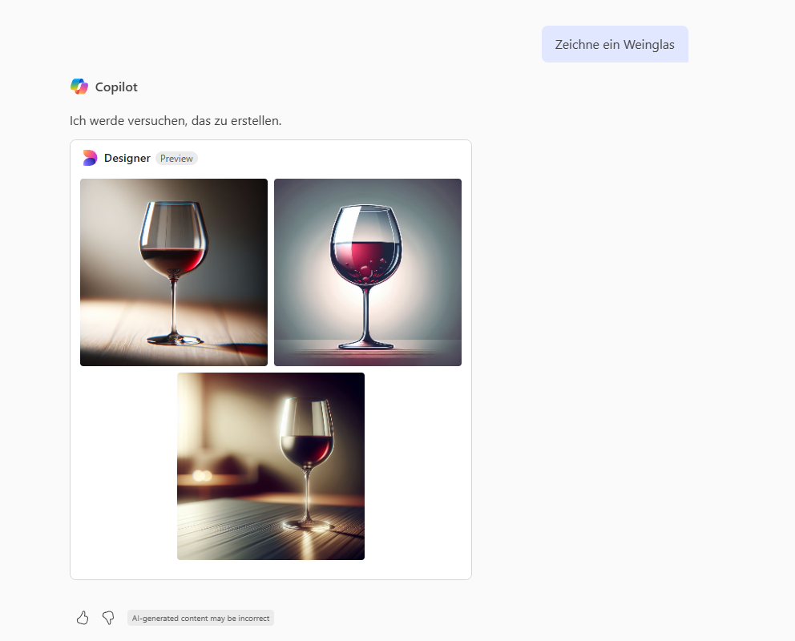
The Fight vs the AI

Slide 11
The Fight vs the AI (Prompt)
Prompts with this wording get better results:
Take a deep breath and work on this problem step-by-step
or
This is very important for my career.

Slide 12
Expectations

Slide 13
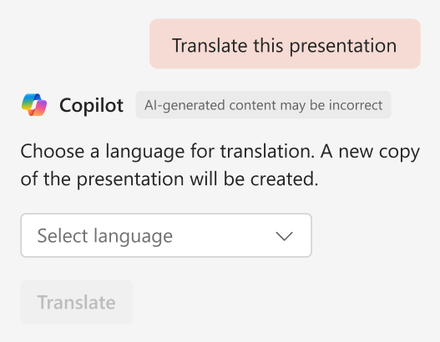
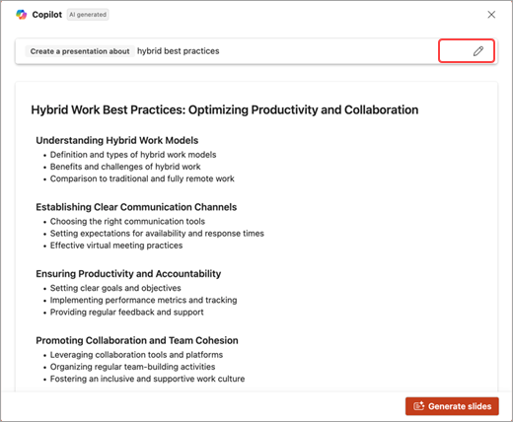
PowerPoint
PowerPoint is LLM driven not Visual
Notes:
Keep your presentations on brand with Copilot in PowerPoint
Brand Images

Slide 14
Limits (Word)
When summarizing content or referencing content while using Copilot to create a draft, keeping the total of all of your referenced content to around 80,000 words or less helps Copilot work effectively.
Asking Copilot questions about the document works best if the document is less than about 7,500 words.
Rewrite works best on a document that is less than about 3,000 words.

Slide 15
Ignite – November 2024

Slide 16
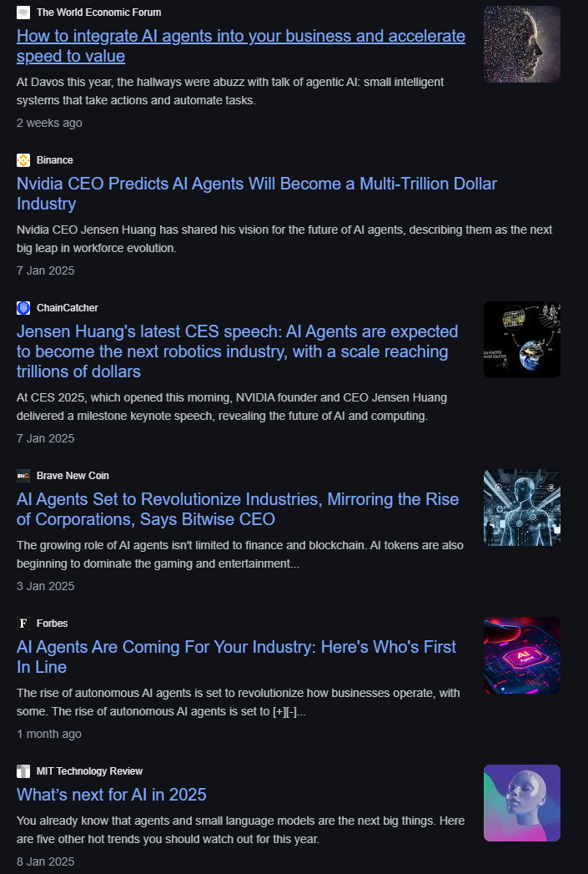
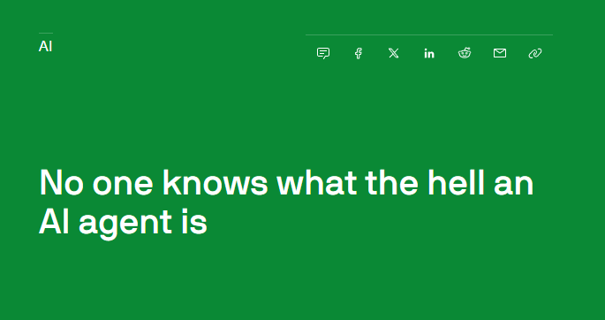
Agents

Slide 17

Copilot is the UI for AI
People
Copilot
Agents
Use Copilot in M365 apps and business chat to transform productivity and realize business value
Copilot is grounded in your data, and protects your data following your governance and security policies
Customize and expand Copilot’s capabilities with agents to run your business processes
17
Notes:
Everything starts with people at Microsoft, and Copilot is the AI assistant that empowers people. Agents enable you to enhance and expand Copilot’s capabilities by connecting them to your data and extending their skills.

Slide 18
What are agents?
Agents uses AI to automate and execute business processes, working alongside or on behalf of a person, team or organization
Simple
Advanced
Retrieval
Retrieve information from grounding data, reason, summarize, and answer user questions
Task
Take actions when asked, automate workflows, and replace repetitive tasks for users
Autonomous
Operate independently, dynamically plan, orchestrate other agents, learn and escalate
Agents vary in levels of complexity and capabilities depending on your need
18
Notes:
Agents exist on a spectrum. Different organizations are at different stages of their AI transformation. Some are advanced and building the next generation of agents with autonomous capabilities. Others are still building out their AI agents to focus on retrieval and task experiences bringing their knowledge and automations into their agent experiences.
These descriptions are not official technical names for your agents. They are used to describe the capabilities that your agent may possess. All agents have the same set of components; however it is down to the makers use case and complexity that dictates where it sits across this continuum.
We recognize that agents has been an industry term used over the years. In 2024, it is mostly associated with the right side of autonomy. We believe everything is an agent and that they live on a spectrum of capability.
Retrieval: Designed with specific instructions on how to behave, their personality, and their overall objectives. They follow predefined rules and guidelines set by the creators.
Task: connected to specific workflows or processes. They operate based on knowledge, skills, and rules based automation. Their primary purpose is to automate repetitive tasks.
Autonomous: Operate independently, dynamically planning and learning from the processes. They adapt to changing conditions and make decisions without constant human intervention.

Slide 19

Declarative agents Implementation
User experience
Knowledge
Agents
Instructions and Grounding
Skills
Actions, capabilities, triggers, workflows
Orchestrator
Autonomy
Planning, exceptions, self-learning
Microsoft provided
Foundation models
Developer provided
19
Notes:
Declarative agents use this architectural stack by leveraging all of the Copilot stack, based on the BizChat model. Declarative agents really steer how Copilot interacts with your users, grounded in your data, as well as actions and capabilities that allow developers to really tailor agents to their needs.

Slide 20





Custom engine agents Implementation
User experience
Microsoft Teams
Microsoft Copilot
Messenger
White label Web chat
Email
+10 other front-end channel
Knowledge
Instructions and Grounding
Agents
Orchestrator
Skills
Actions, triggers, workflows
Autonomy
Planning, exceptions, self-learning
Microsoft provided
Foundation models
Developer provided
20
Notes:
The difference with M365 Agents SDK is that there are many more user experience options.

Slide 21



MAKING INFORMATION WORKERS MORE PRODUCTIVE
TRANSFORMING ENTERPRISE BUSINESS PROCESSES
BUILDING CUSTOM AI SOLUTIONS
M365 Copilot
+ Copilot Studio
Azure AI Foundry
+
Copilot Studio
Copilot Studio
Notes:
Let’s begin by zooming out and talking about AI transformation. At the highest level, there are three major categories of AI business transformation. Using AI to make your employees more productive, using AI to transform you enterprise processes, and building custom AI solutions. And Copilot Studio has a role to play in each of those categories. Let’s have a closer look.

Slide 22
Today

Slide 23
Links
Claim your digital Badge: http://globalai.community/eventbadge/20250
Code: 31V9TW
Join our Chapter to get Information about future events:
https://globalai.community/chapters/vienna
We are looking for sponsors! vienna@globalai.community

Slide 24
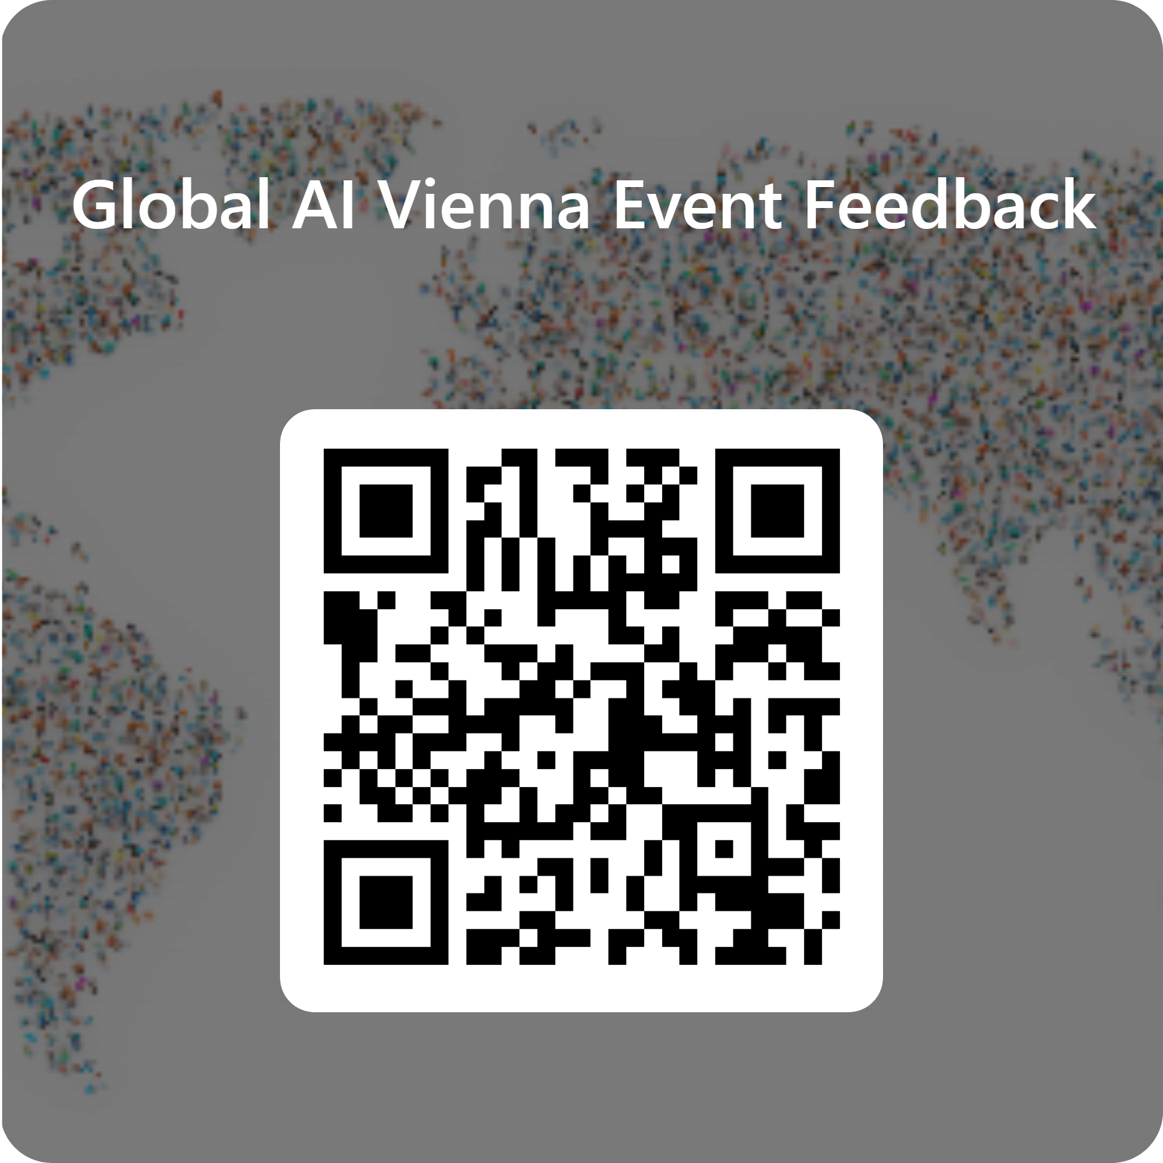

Feedback
We hope you liked this community event!
https://forms.office.com/e/ibWxDVkjei
https://globalai.community/chapters/vienna
Notes:
All the demos are here!

Slide 25
Thank you!
https://globalai.community/chapters/vienna
Notes:
All the demos are here!

